Slide 1
Model-Engine-Handler (MEH) Architectural Design Pattern for Clean Models
Luke Machowski
20th August 2018

Slide 2
Objectives
Alternative to OOP design which allows for extensibility
Design Pattern that acknowledges that the Public API is separate from the Private API
It can version at a different rate.
Allows a complete overhaul of the internals without affecting the consumers of the public API.
Stateless Engine for easy unit testing.

Slide 3
Principles that Help us Achieve our Objectives
If you want clean unit tests, you need clean models.
Clean models come from separating out the intrinsic complexity from the accidental complexity.
Think “In-Memory” for your clean models.
Think “What would it look like in a NoSQL Database” to separate model fields from DTO fields.
Persistence is a consequence of the clean model design, not the core of it.
When it comes to behaviour, prefer composition over inheritance.
We can compose a large complex operation from simpler smaller implementations.
Inheritance can rather be used for mocking out or overriding functionality for testing (non-functional concerns).

Slide 4
Coding Layers
HTML View
Binding
Scope / View Model
UI Component
UI Controller
Angular etc…
UI Service
HTTP Request…
REST Client
REST Framework…
Resource/MVC Controller
REST API
DTO for REST
Manager Layer
Dependency Injection Layer
Spring etc…
Model
Logical Layer
DTO for Storage
Repository
ORM
Storage Framework…
DB

Slide 5
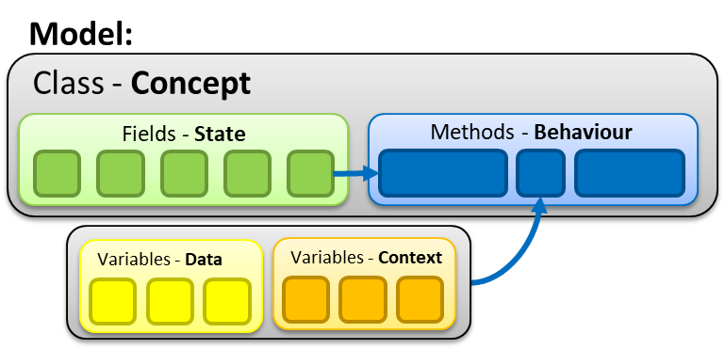
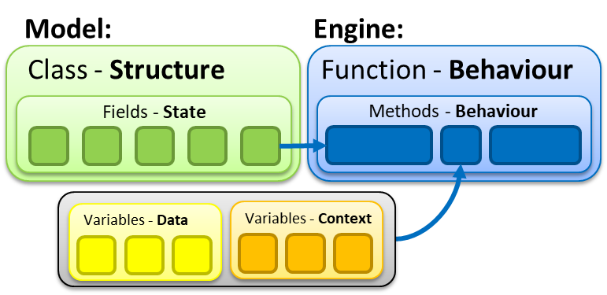
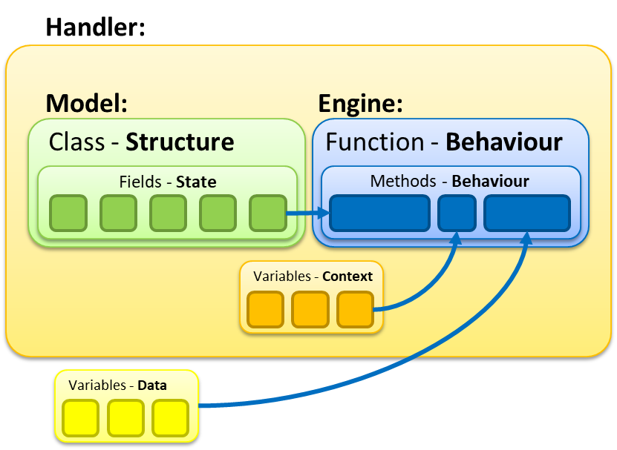
Model Architectures
There are at least 3 architectural patterns here for the model
HTML View
Binding
Scope / View Model
OOP
UI Component
UI Controller
Angular etc…
UI Service
1
HTTP Request…
REST Client
Model + Engine
REST Framework…
Resource/MVC Controller
REST API
2
DTO for REST
Manager Layer
Dependency Injection Layer
Model + Handler + Engine
Spring etc…
Model
Logical Layer
DTO for Storage
3
Repository
ORM
Storage Framework…
DB

Slide 6
3 Model Architectures
The handler represents a clean and concise API and a place to store common context, so the caller of the API doesn’t need to keep providing it.
The model has everything. The context and data is passed into the behaviour, which might update the model state.
1
OOP
Model:
3
Model + Handler + Engine
Class - Concept
Handler:
Fields - State
Methods - Behaviour
Model:
Engine:
Variables - Data
Variables - Context
Class - Structure
Function - Behaviour
Fields - State
Methods - Behaviour
Model:
Engine:
Variables - Context
Class - Structure
Function - Behaviour
Fields - State
Methods - Behaviour
Variables - Data
Variables - Data
Variables - Context
The engine is a stateless implementation of pure logic (functional).
2
Model + Engine

Slide 7
Model Smudge
HTML View
Binding
Scope / View Model
UI Component
UI Controller
Angular etc…
UI Service
HTTP Request…
REST Client
By not having an explicit Domain Model Layer, the logic is smudged across the other layers, which makes it very hard to unit test.
REST Framework…
Resource/MVC Controller
REST API
DTO for REST
Manager Layer
Dependency Injection Layer
Spring etc…
Model
Logical Layer
DTO for Storage
Repository
ORM
Storage Framework…
DB

Slide 8
Pull out the Intrinsic Complexity into the Model
Step 1 is to pull out the Intrinsic Complexity from the Accidental Complexity.
Intrinsic Complexity is the complexity of the pure problem at hand.
Accidental Complexity is what we introduce when we try to implement it.
Create Model classes for the Intrinsic Structure
Create an Engine for the dynamic behaviour behind that Intrinsic Complexity
There are at least 3 architectural patterns here:
OOP: Structure + State (Fields) + Behaviour (Methods) in the class = OOP Model
Engine Only: Structure (Model) + Stateless API + Behaviour (Engine)
Engine with Handler: Structure (Model) + Stateful API (Handler) + Behaviour (Engine)

